Slide 1
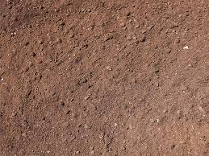
Soil pollution

Slide 2
Definition-The alteration in the physical, chemical and biological properties of soil due the presence of pollutant and effecting the soil natural productivity/ fertility is called soil pollution.

Slide 3
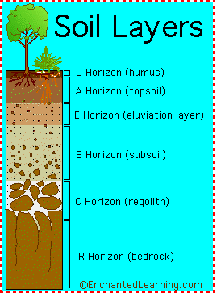
O-horizon: freshly-fallen & partially-decomposed leaves, twigs, animal waste, fungi & organic materials. Colour: brown or black.
A-horizon: humus/partially decomposed organic matter & some inorganic mineral particles. darker & looser than the deeper layers.
O& A-horizon: contain a large amount of bacteria, fungi, earthworms, small insects, forms complex food web in soil, recycles soil nutrients, & contribute to soil fertility.
B-horizon /(subsoil): less organic material & fewer organisms than A- horizon.
C-horizon: consists of broken-up bedrock, does not contain any organic materials. Chemical composition helps to determine pH of soil & also influences soil’s rate of water absorption & retention.
R-horizon: The unweathered rock (bedrock) layer that is beneath all the other layers

Slide 4
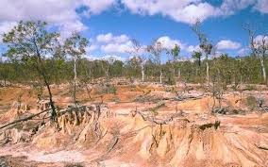
Sources of Soil Pollution:
There are several materials, which adversely effect the physical, chemical and biological properties of the soil and thus reduce its productivity.
These are:
Soil erosion
Chemicals present in industrial waste.
Pesticides and insecticides that are sprayed on crops.
Solid waste dumping in the land.
Fertilizers and manures that are added to the soil to increase the crop yield.
Excess use of irrigation water
Intrusion of saline water to agriculture land.

Slide 5
Effect of soil pollution:
Chemicals and pesticides affect the structure and fertility of soil by killing the soil micro-organisms and macro-organisms likes earthworms.
Food shortage: The foremost effect of loosing top soil is causing water pollution and reduced food production leading to food shortage. With population growth, it becomes more critical.
Pesticides are absorbed by the plants and then transferred to other organism and finally to human body through the food chains and food webs.
Pathogens present in the wastes and excreta contaminate the soil and vegetable crops causing diseases in man and domesticated animals.
Fertilizer run off leads to the eutrophication of waterways.

Slide 6
Desertification: Continuous exposure of eroded soil to sun for longer periods may transform the land into sandy and rocky in nature. These are symptoms of desertification rendering the soil unsuitable for cultivation.
Decrease in the extent of agricultural land
Top soil which is washed away also contributes water pollution by clogging of lakes, and increasing turbidity of water, ultimately leading to loss of aquatic life.
Excess use of irrigation leads to water logging and soil Stalinization

Slide 7
Soil Erosion in India
Soil erosion is a worldwide phenomenon, but it is especially high in Central Africa, China, India, Nepal, Australia, Spain, USA and USSR.
India loses about 40,000 hectares of land every year as an effect of wind and water erosion.
Erosion damage to 18.5% the topsoil of the world.
This is due to overgrazing by livestock.
The population of livestock in India is the highest in the world.
Overgrazing damages the topsoil, which reduces soil fertility.

Slide 8
Shifting cultivation
Tribal communities follow the practice of cutting down trees and setting them on fire and then raising the crops on the resulting ash.
This is called Jhuming in northeastern India.
It is harmful if the Jhuming cycles are longer than ten years but short cycles destroy forests and cause soil erosion. e.g. Asia and Africa.

Slide 9
Developmental activities
Large areas of fertile and productive croplands, woodlands and grasslands are lost to various developmental activities such as rapid urbanization, building of airports, industries, railways, roads, mining and construction of dams.

Slide 10
Control measures:
Proper soil conservation measures to minimize the loss of top soil
INM, IPM, using bio pesticides and integrated environment friendly agriculture to reduce pesticides or fertilizers.
Use of cattle dung and agricultural wastes in biogas plants should be encouraged.
Appropriate water management practices in agriculture.
Keeping the soil surface covered with crop residues or crop cover
Planting trees as a part of afforestation/ shelter belts/wind breakers
Cleaning up polluted soil

Slide 11
Bioremediation
The use of naturally occurring microorganisms such as bacteria, fungi & plants to break down or degrade toxic chemical compounds that have accumulated in the environment

Slide 12
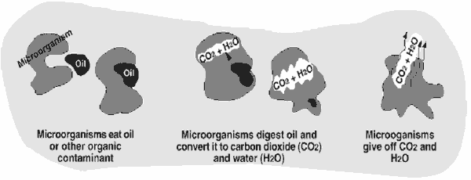

Slide 13
Process requirements:
Conditions that favor Bioremediation include the followings:
• Temperature favorable for organisms
• Availability of water
• Availability of nutrients(N,P, K)
• C:N ratio of the contaminant material
• Availability of oxygen in sufficient quantity in the soil

Slide 14
Types of Bioremediation
In situ Bioremediation : The treatment in place without excavation of contaminated soils or sediments.
Ex situ bioremediation: requires pumping of the groundwater or excavation of contaminated soil prior to remediation treatments.

Slide 15
Advantages of Using Bioremediation Processes Compared With Other Remediation Technologies
biologically-based remediation detoxifies hazardous substances instead of merely transferring contaminants from on environmental medium to another;
(2) bioremediation is generally less disruptive to the environment than excavation-based processes.
(3) The cost of treating a hazardous waste site using bioremediation technologies can be considerably lower than that for conventional treatment methods: vacuuming, absorbing, burning, dispersing, or moving the material .

Slide 16
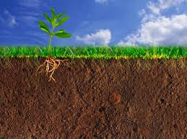
The End

